Slide 1


COVID -19 DATA ANALYTICS AND FORECASTING
Proud Cockroaches team
Faculty of Computer Science and Engineering
Ho Chi Minh University of Technology (HCMUT)

Slide 2

Abstract
This project gives an overview of the most recent pandemic of the novel coronavirus 2019 (COVID-19) and shows how data analysis of such an epidemic plays an important role for further predictions and even predictions of future situations.

Slide 3
Main
sections
Explanatory data analysis (EDA)
SIR model
ARIMA model
Other models

Slide 4

Introduction
The key to understanding the pandemic begins with understanding the disease itself and how the disease progresses naturally. Accurately predicting the rate of spread and infection can help minimize the outbreak by taking precautionary measures. However, forecasting requires data and there are various data processing challenges.
Machine learning gives human the potential to make more accurate data-driven decisions and to solve problems that have stumped traditional analytical approaches.

Slide 5
01
Explanatory data analysis (EDA)
What do we achieve from data analysis?

Slide 6


Data sources
Our World in Data (OWID)
John Hopkins university (JHU)
https://github.com/owid/covid-19-data
https://github.com/CSSEGISandData/COVID-19
6 adopted countries:
+ 3 countries with highest number of cases: US, Brazil, India
+3 Asian countries: Japan, Korea, Vietnam

Slide 7
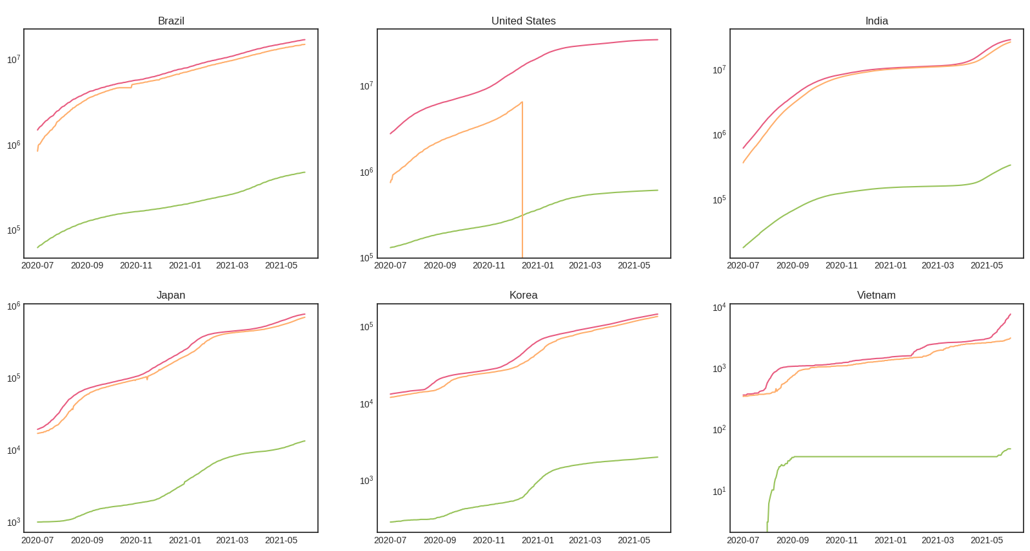
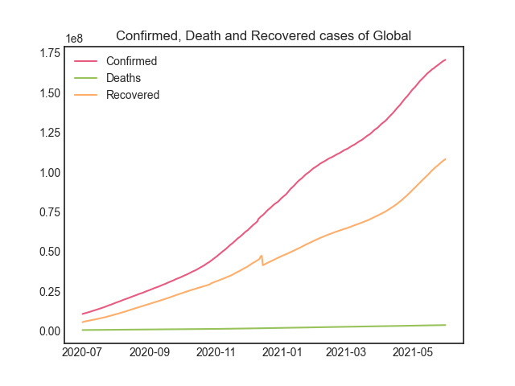
Graphs
Cumulative C, D, R Global
Cumulative C, D, R by country (in log scale)
_ Similar trends: increasing
_ US contains missing values of Recovered -> affect the data of Global

Slide 8
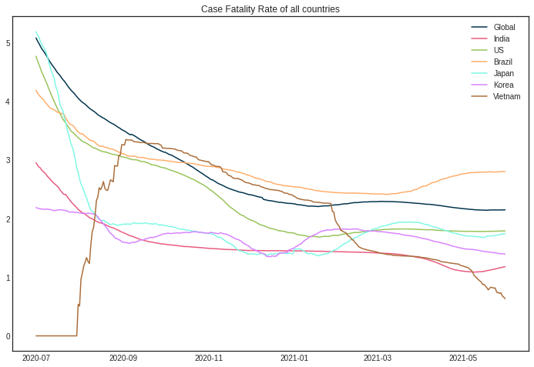
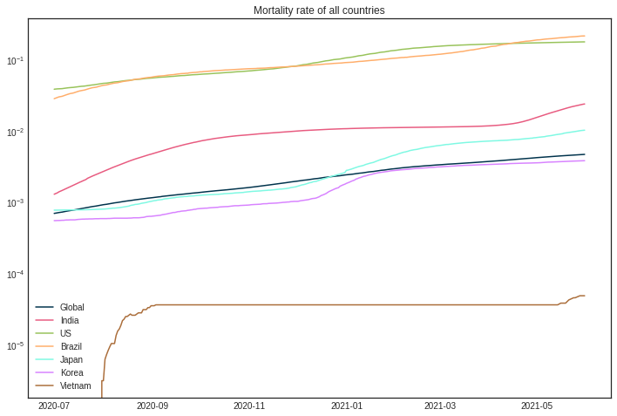
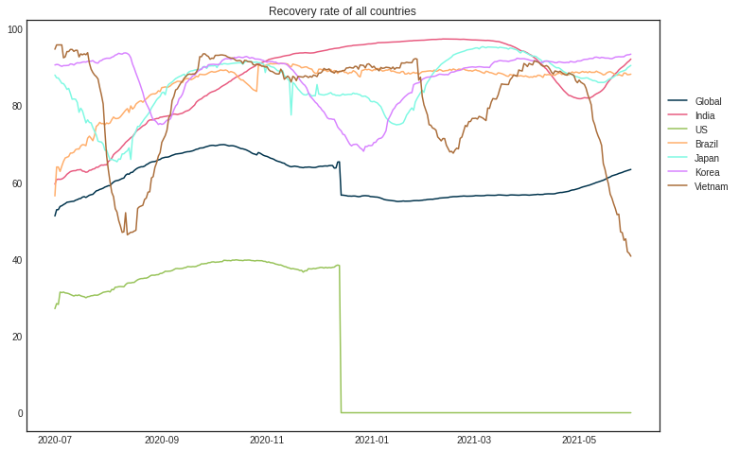
More graphs
(only by country)
Case-fatality rate
Mortality rate
Recovery rate
_ Overall: CFRs are decreasing, recoveries are horizontal -> countries have control over the pandemic.
_ Mortality rate slightly increase -> there might be death records for other reasons rather than COVID-19 itself.
We still have to take into account that COVID-19 is dangerous disease and if we don't make efforts to control it, the death rate could rise exponentially to the point of unreachable.

Slide 9
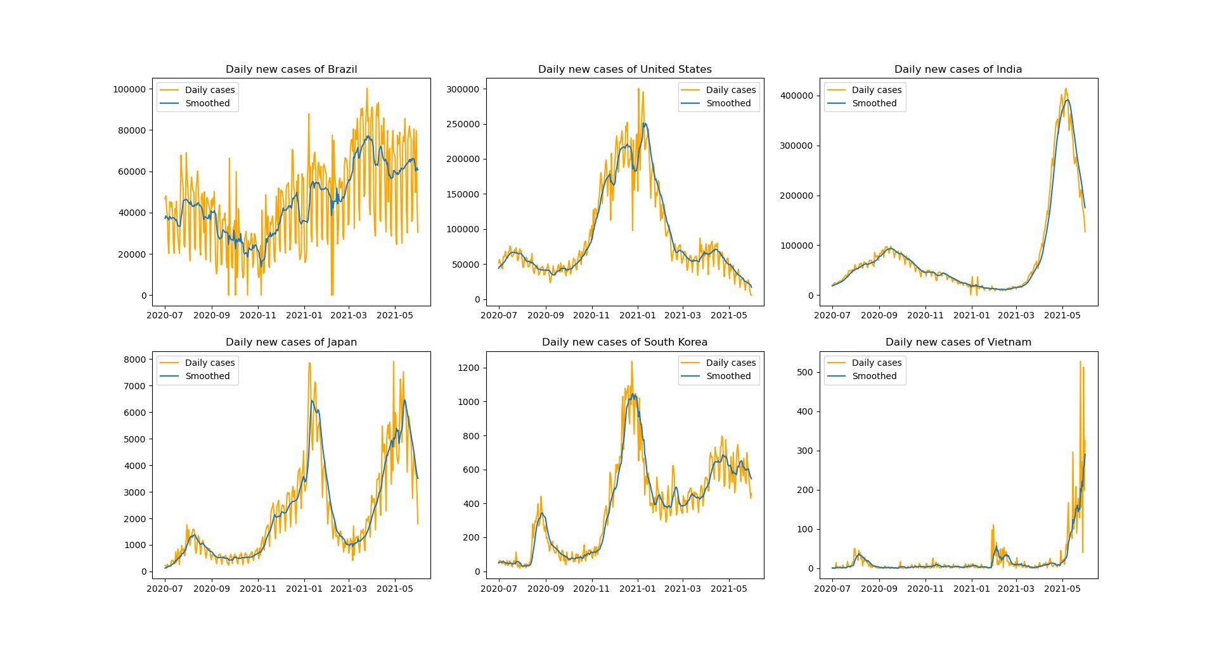
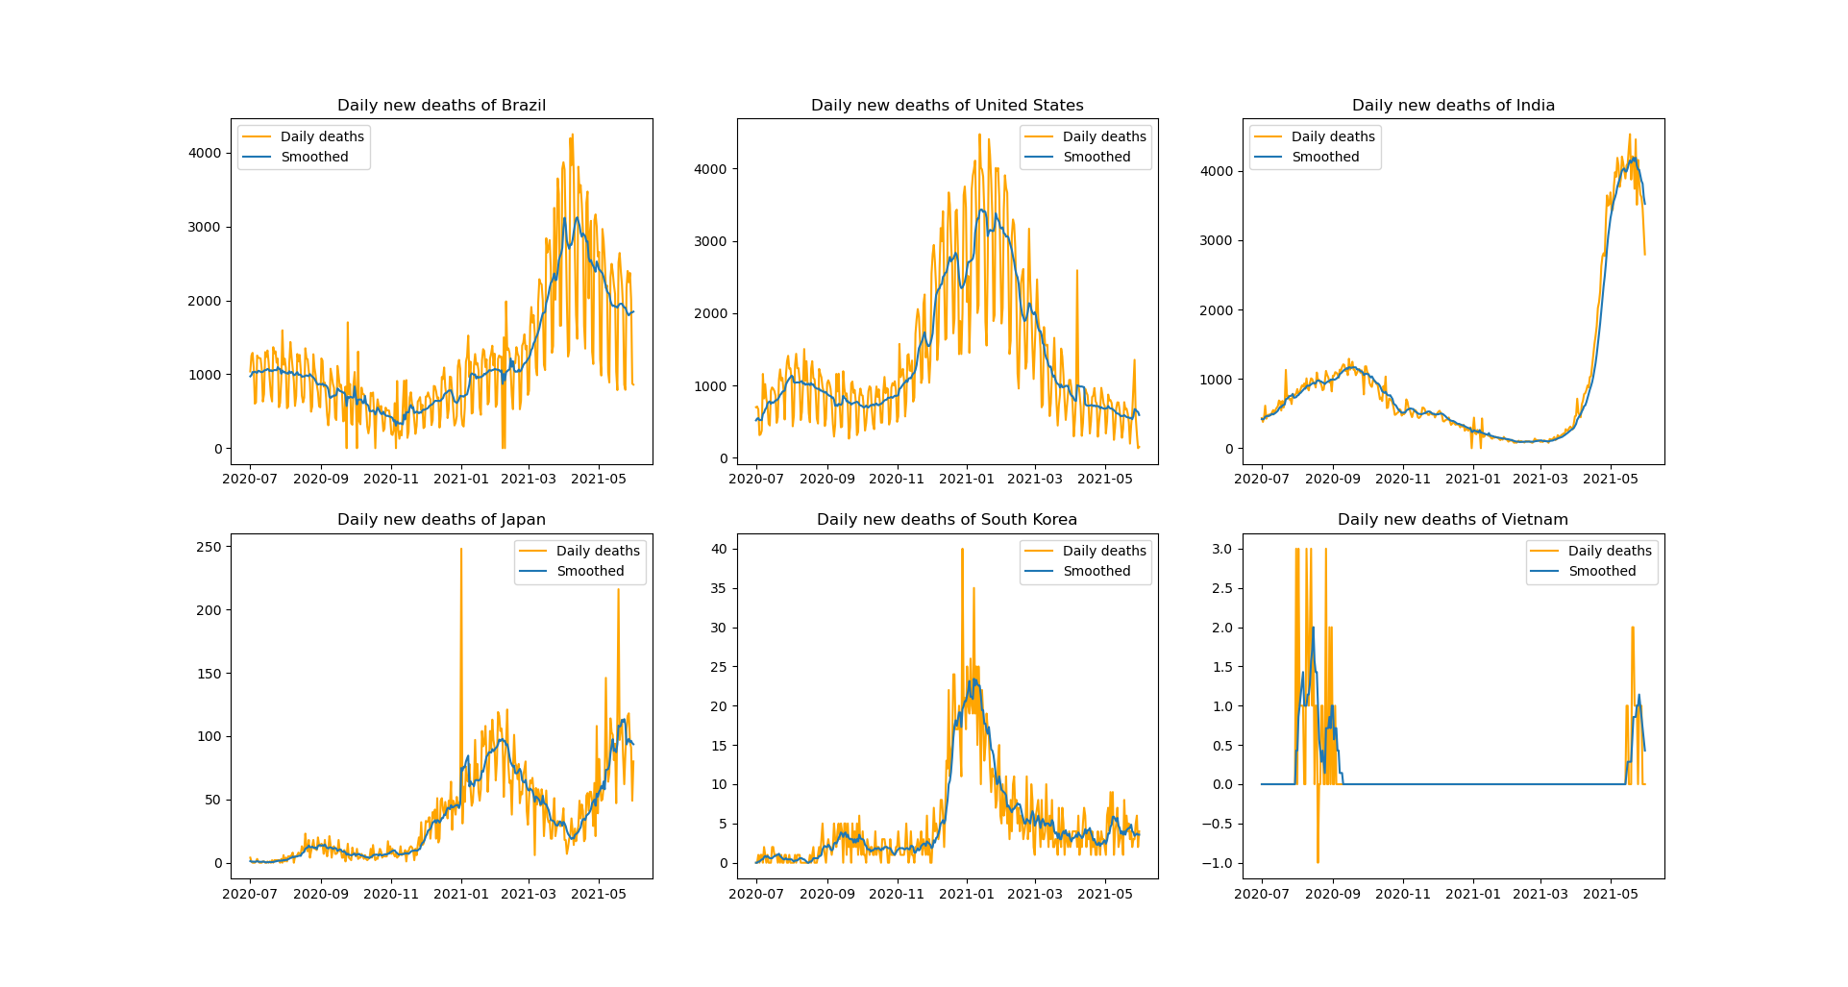
More graphs
(only by country)
Daily new cases
Daily death reports
The number varies. Overall trend is increasing.

Slide 10
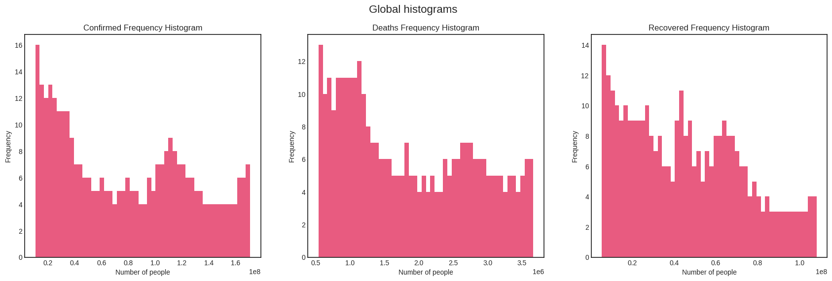
Distributions
(Global)
C, D, R frequency histograms for Global
No obvious distribution is found. Mostly right-skewed and have random spikes.

Slide 11
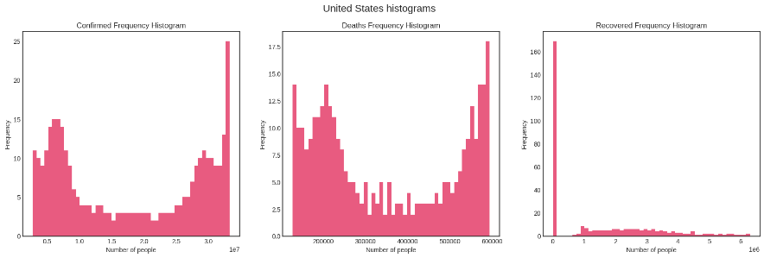
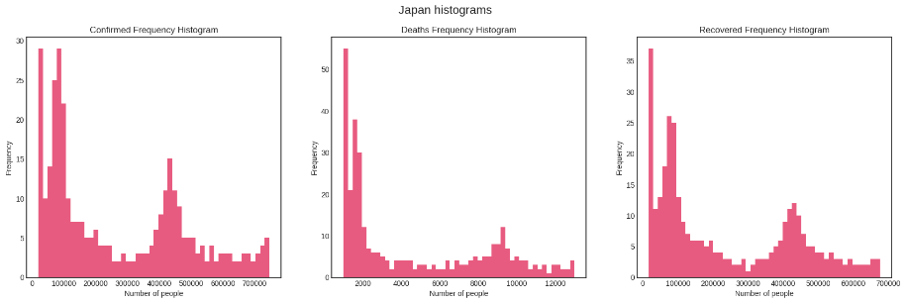
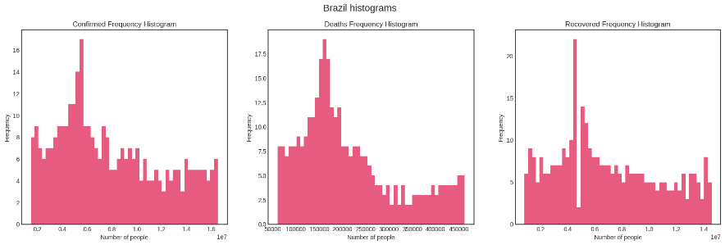
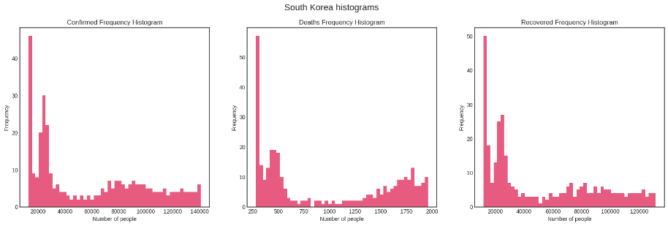
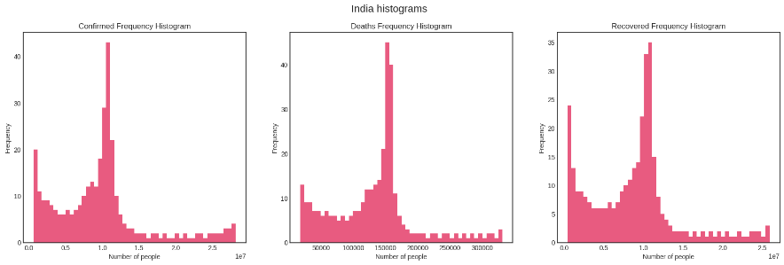
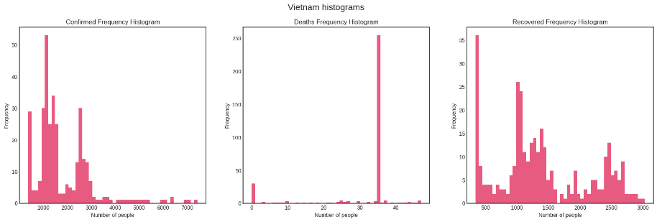
Distributions
(by country)
Highest number of cases:
US, Brazil, India
Asian countries:
Japan, Korea, Vietnam
No obvious distribution is found. Mostly right-skewed or randomly distributed.

Slide 12
02
SIR model
A common compartmental model in epidemic study.

Slide 13
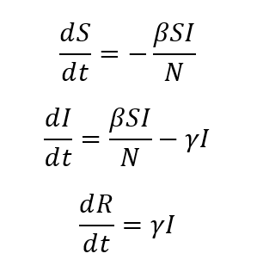
SIR model divides a fixed population of N people into 3 compartments:
Susceptible (S): The individual has not contracted the disease, but can be infected due to transmission from infected people.
Infected (I): The individual has contracted the disease.
Recovered (R): The individual has survived and developed immunity to the disease or is deceased.
With beta ( β ): probability susceptible–infected contact results in a new exposure; gamma ( γ ): probability of one infected subject gets recovered; these coefficients are modifiable.

Slide 14
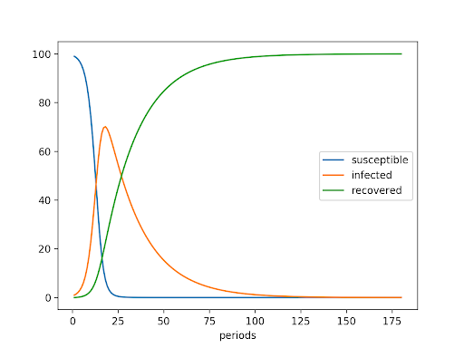
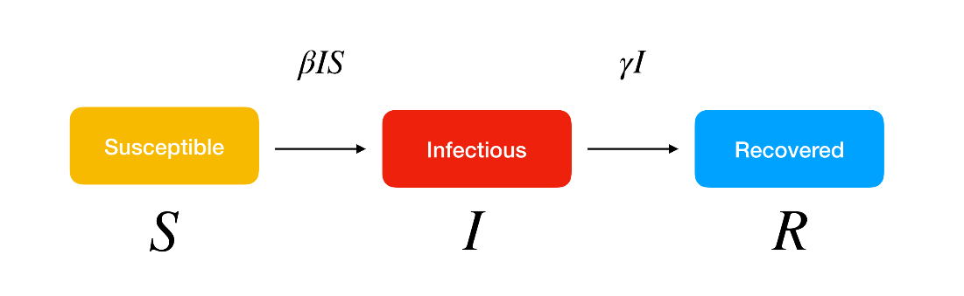
The curves change as β and γ changed -> make decisions in order to change these parameters.

Slide 15
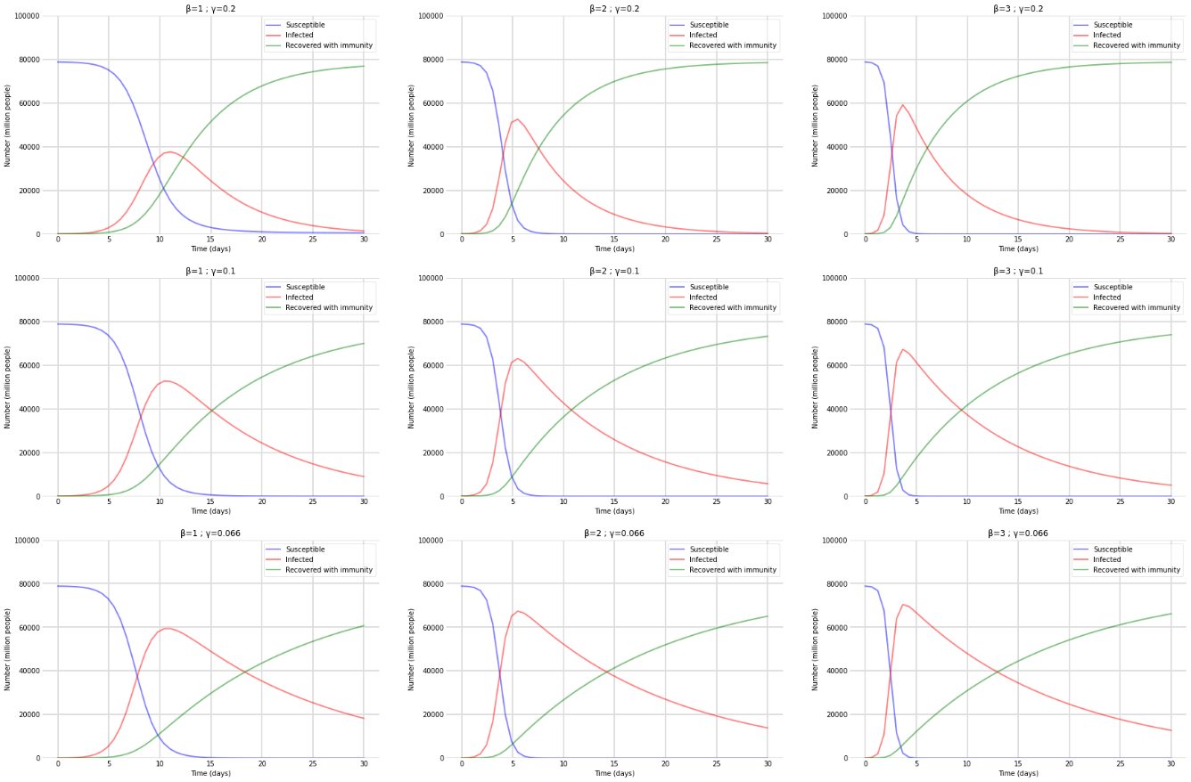
Results
The same process applied for the rest of the regions.
First, a fixed γ = 0.2 is selected and the three different values for β are considered:
β = [1, 2, 3]. This means that the proposed simulation will consider different possibilities for the capacity of the virus to spread through personal contacts and its inherent rate of transmission.
The same process is then repeated for γ = 0.1 and γ = 0.066.
(Global) Respectively:
γ = 0.2 and β = [1, 2, 3
γ = 0.1 and β = [1, 2, 3]
γ = 0.066 and β = [1, 2, 3]

Slide 16
Observations
At the start of the period, the number of infected individuals increases if β > γ and vice versa.
The number of susceptible individuals decreases over time.
The number of infected individuals reaches a peak, then decreases over time. This occurs sooner as the parameter β increases.
All compartments flatten out after a period of time, which occurs sooner as the parameter γ increases.
The number of recovered or deceased individuals increases more or less significantly as the number of infected individuals increases or decreases respectively.

Slide 17
03
ARIMA model
A useful model for forecasting time-series data.

Slide 18
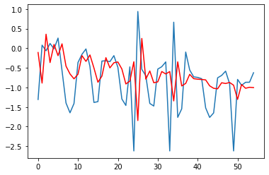
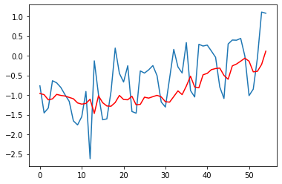
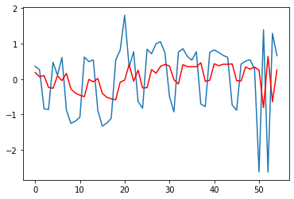
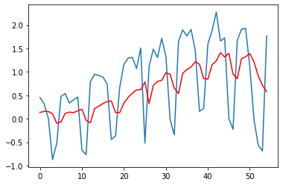
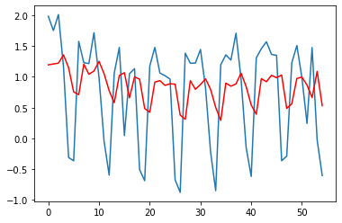
Results
Sample 1
Sample 2
Sample 3
Sample 4
Sample 5
Brazil – ARIMA (0,1,2)

Slide 19
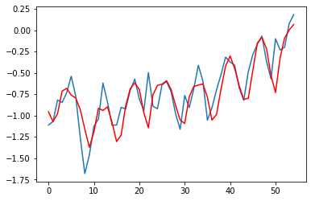
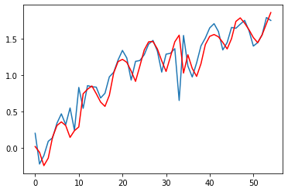
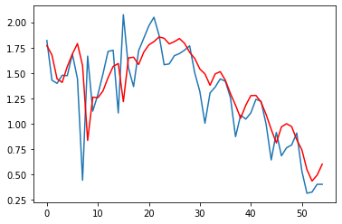
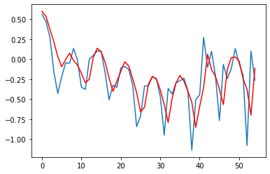
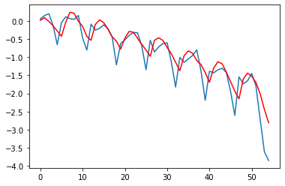
Results
Sample 1
Sample 2
Sample 3
Sample 4
Sample 5
US – ARIMA (2,1,3)

Slide 20
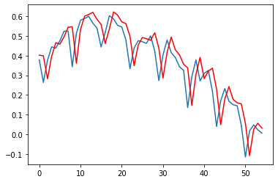
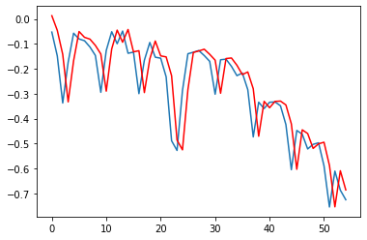
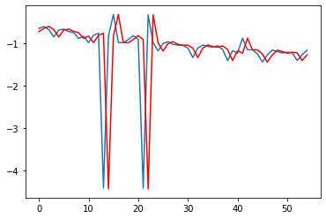
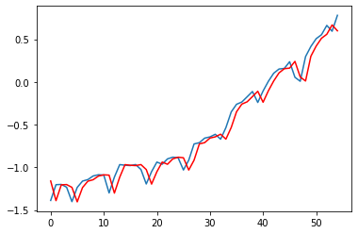
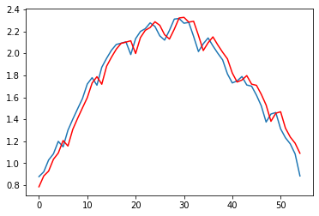
Results
Sample 1
Sample 2
Sample 3
Sample 4
Sample 5
India – ARIMA (0,1,0)

Slide 21
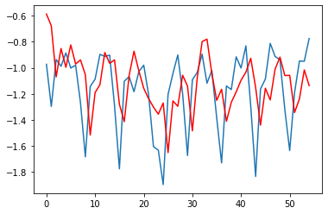
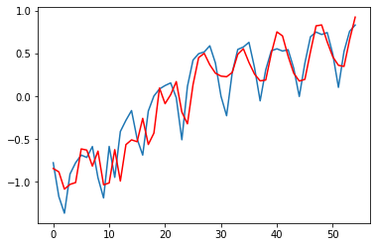
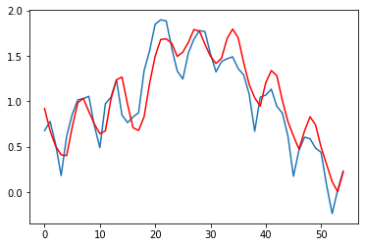
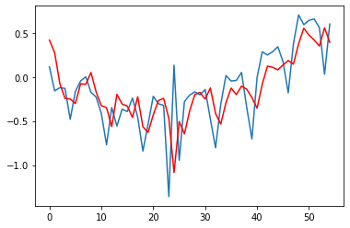
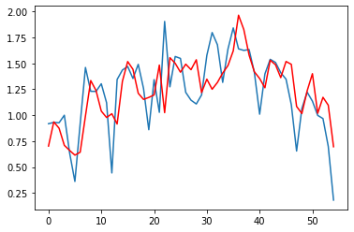
Results
Sample 1
Sample 2
Sample 3
Sample 4
Sample 5
Japan – ARIMA (2,1,3)

Slide 22
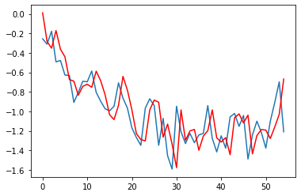
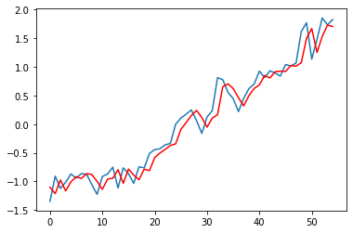
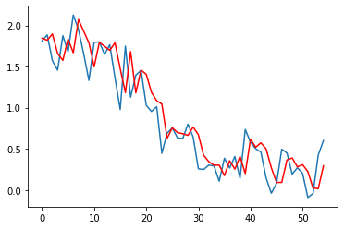
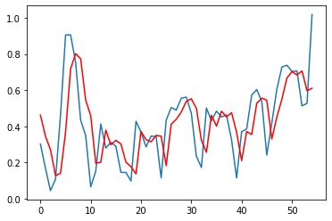
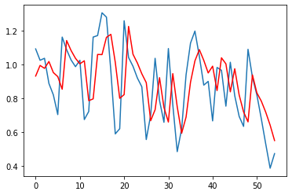
Results
Sample 1
Sample 2
Sample 3
Sample 4
Sample 5
Korea – ARIMA (2,1,2)

Slide 23
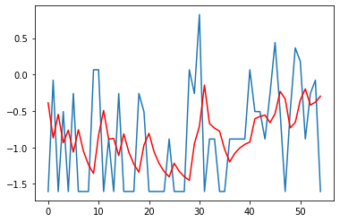
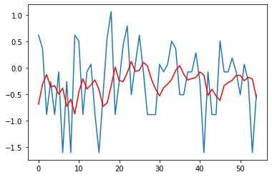
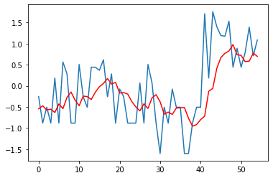
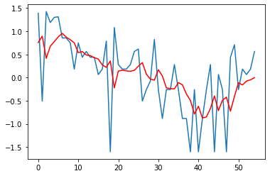
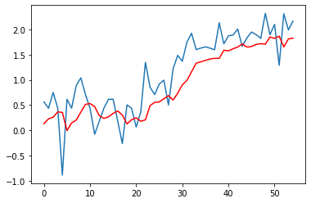
Results
Sample 1
Sample 2
Sample 3
Sample 4
Sample 5
Vietnam – ARIMA (1,0,1)

Slide 24
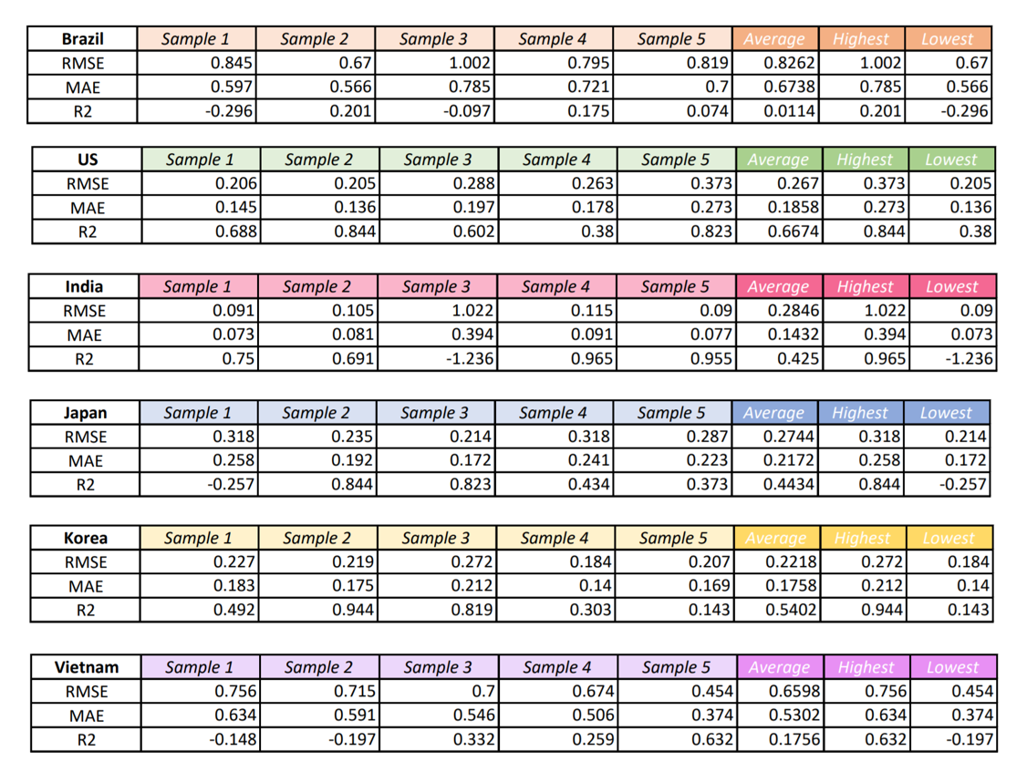
Observations
The table shows final scoring results of modes. These score are considered low accuracy -> one of the reason comes from the data not stationary. Hence we need more data transforming operations.

